Slide 1

Electronic Mailroom
The Rain-Men
2/c Hali Hanley, 2/c Julie Brisbane, 2/c Maddison Maloney, 2/c Casey Owen

Slide 2

Problem Statement
Cadet mail process is an ongoing problem that leads to wasted productivity for both CGA mailroom staff and cadets.
This project outlines a fully digital workflow management system for the mailroom.
Our specific idea for CGA is a mailing system for cadets to be notified when their packages are sorted and ready for pick-up.
Notes:
Outline of how the mailroom works
How everything is done from the cadet perspective
Madison

Slide 3
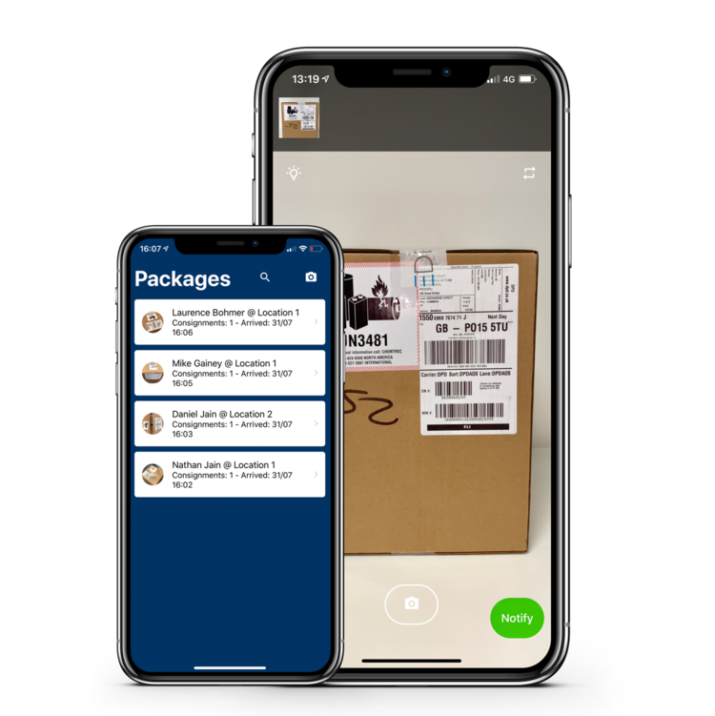
Initial Solution
A mailroom app
Keeps all the information in app
Package data, cadet data, mailroom data
Notify the user when there is a package
Electronic “note card”
Notes:
Madison

Slide 4

Interviews
Mail Room
Faster sorting process with query
Less questioning of cadets
Cadet Survey
86% would download an app
Free response: many requests for email notification
IT Department
Additional constraints, difficulty of brand new application development
Suggestion of existing Microsoft 365 app
Compatible with current database necessary
Notes:
julie

Slide 5
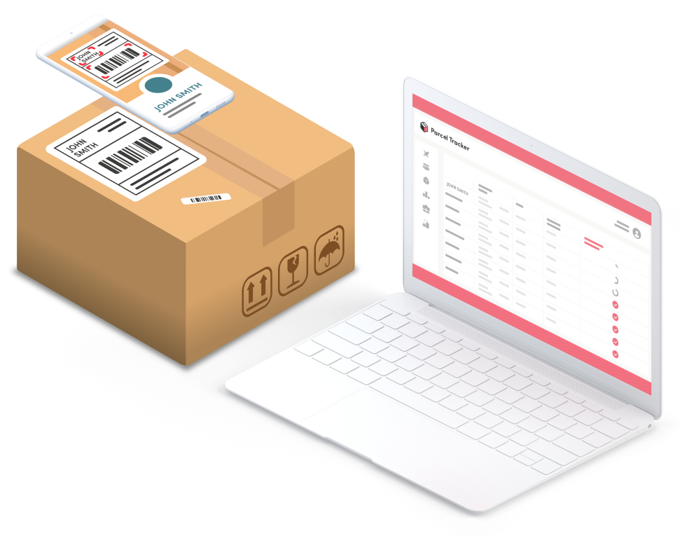
Proposal
Utilize the EDU system
Find existing Office 365 services
Connect existing system to Outlook service
Saves time for both Cadets & Mailroom staff
Mailroom staff will search the cadets’ names or P.O. box number in the system to connect with the correct email.
Notes:
hali

Slide 6

Cost Benefit Analysis
Close to zero monetarily
Free application, possibility of new laptops (or existing)
Time cost
Stakeholder approval time
Additional in-depth testing
Training mailroom staff
Low human resources needed
Benefits
Easier process for mailroom
Less exhaust of cadets checking for packages
Replacement of outdated system
Notes:
julie

Slide 7
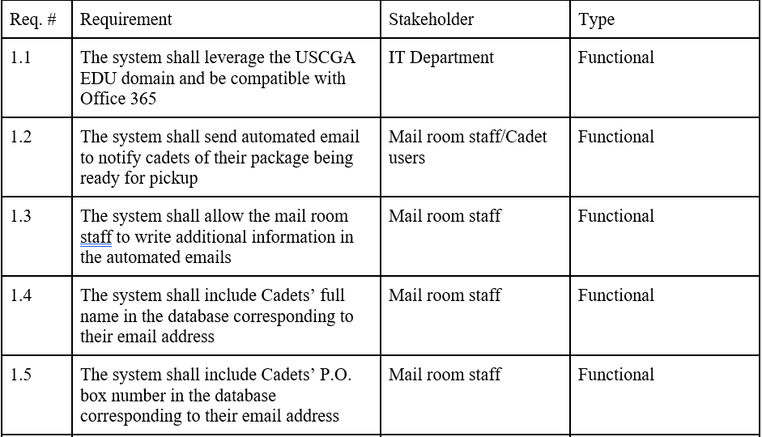
Requirements
Notes:
julie

Slide 8
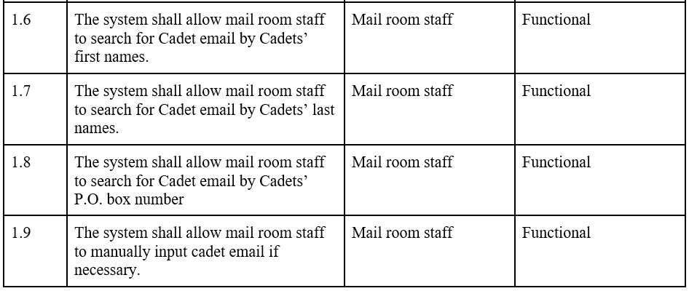
Requirements Continued

Slide 9
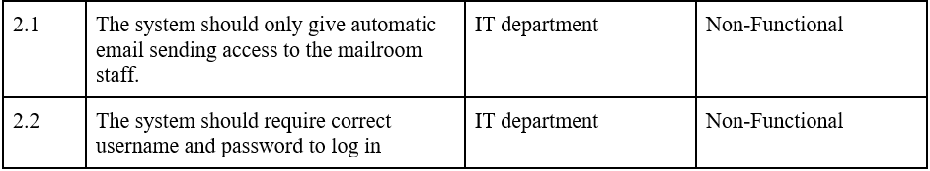
Non-Functional Requirements

Slide 10
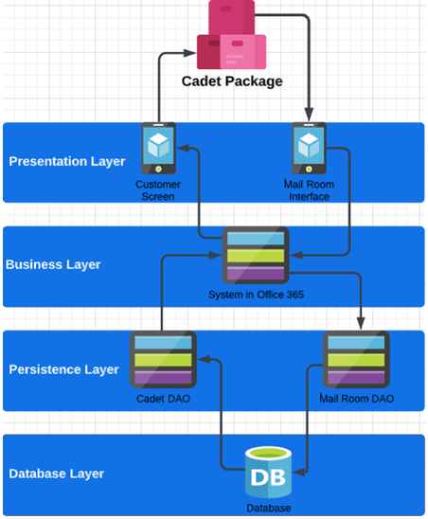
Architecture
Four-Layered Architecture
Presentation Layer
Interface for Mailroom staff & Cadets
Notification System
Business Layer
Input → Cadet Information
Power Automate & Outlook
Persistence Layer
Bulk of the workflow
DAOs connect to specific service
Database Layer
Holds all the information of Cadet’s (Name, Email address, & PO Box #)
Connects the DAOs
Notes:
hali

Slide 11
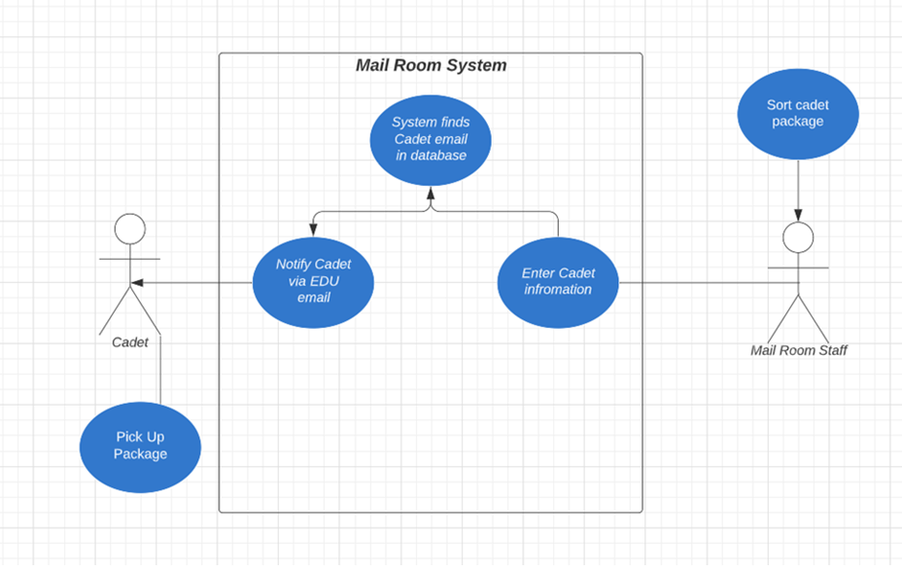
Workflows
System receives either P.O. Box #, first name, or last name
Power Automated sorts and writes query
Box number takes priority as unique identifier
First name and last name entries require more sorting
When email found, system sends automated email
Notes:
casey

Slide 12
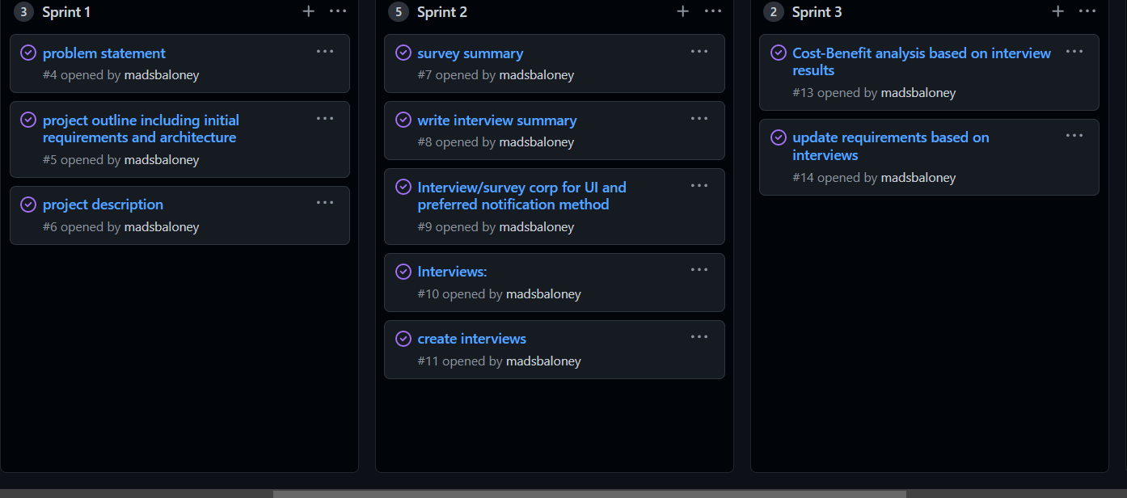

Team Assessment & Complexity
Complexity skills we learned in class
Broken down into sprints
Each sprint assigned tasks
Teamwork and Collaboration
Divide and Conquer
Strengths and Weaknesses
Notes:
madison

Slide 13
Conclusion
Large Potential for implementation at the Academy
Need modernized system for the mailroom
Worked through software engineering process and adapted idea to stakeholder requirements
Further work:
Propose to stakeholders
Larger testing
Training mailroom
Possibility to connect scanners with the automated email system in the future
Notes:
Casey present

Slide 14
Demonstration
Notes:
Casey

Slide 15
QUESTIONS?

